Slide 1
IPv4 (Internet Protocol version 4)

Slide 2
Some basics term of IP
The term internet is short for “internetworking”
– interconnection of networks with different network access mechanisms, different routing techniques, etc.
An internet
– Collection of communications networks interconnected by layer 3 switches and/or routers
The Internet - note the uppercase I
The global collection of individual machines and networks
IP (Internet Protocol)
most widely used internetworking protocol
foundation of all internet-based applications

Slide 3
Internet Protocol (IP)
IP provides connectionless (datagram) service
Each packet treated separately
Network layer protocol common to all routers
which is the Internet Protocol (IP)
Connectionless Internetworking (General)
Advantages
Flexible and robust
e.g. in case of congestion or node failure, packets find their way easier than connection-oriented services
No unnecessary overhead for connection setup
Can work with different network types
Disadvantage
Unreliable
Not guaranteed delivery
Not guaranteed order of delivery
Reliability is responsibility of next layer up (e.g. TCP)

Slide 4

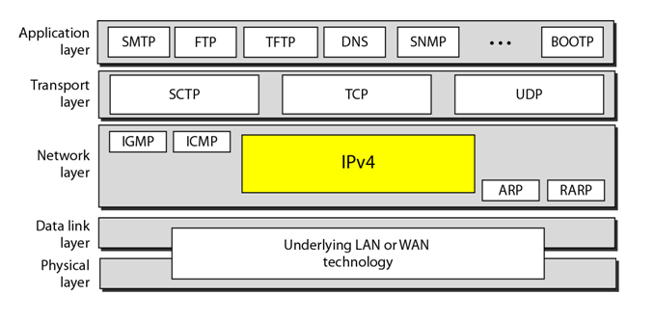
Internet Protocol (IP) Version 4

Slide 5
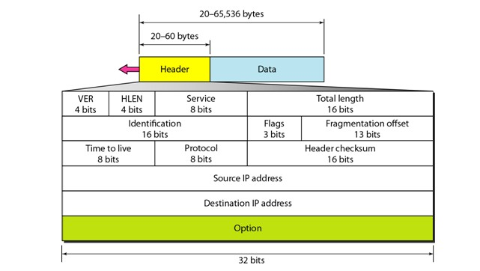
Header + Data using IPv4

Slide 6
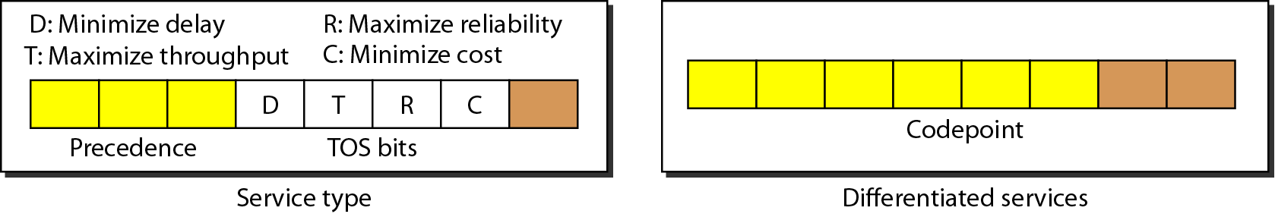
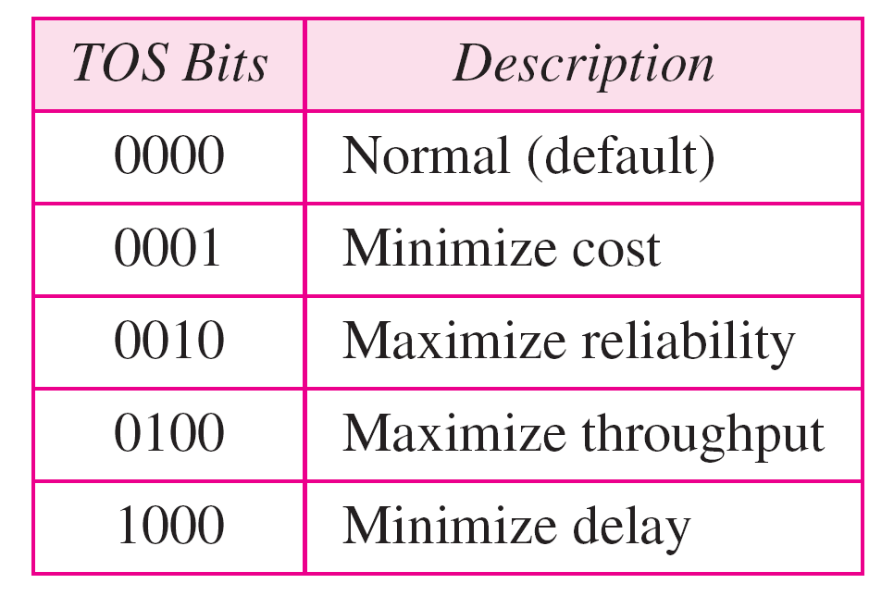
Types of service
Service type or differentiated services

Slide 7
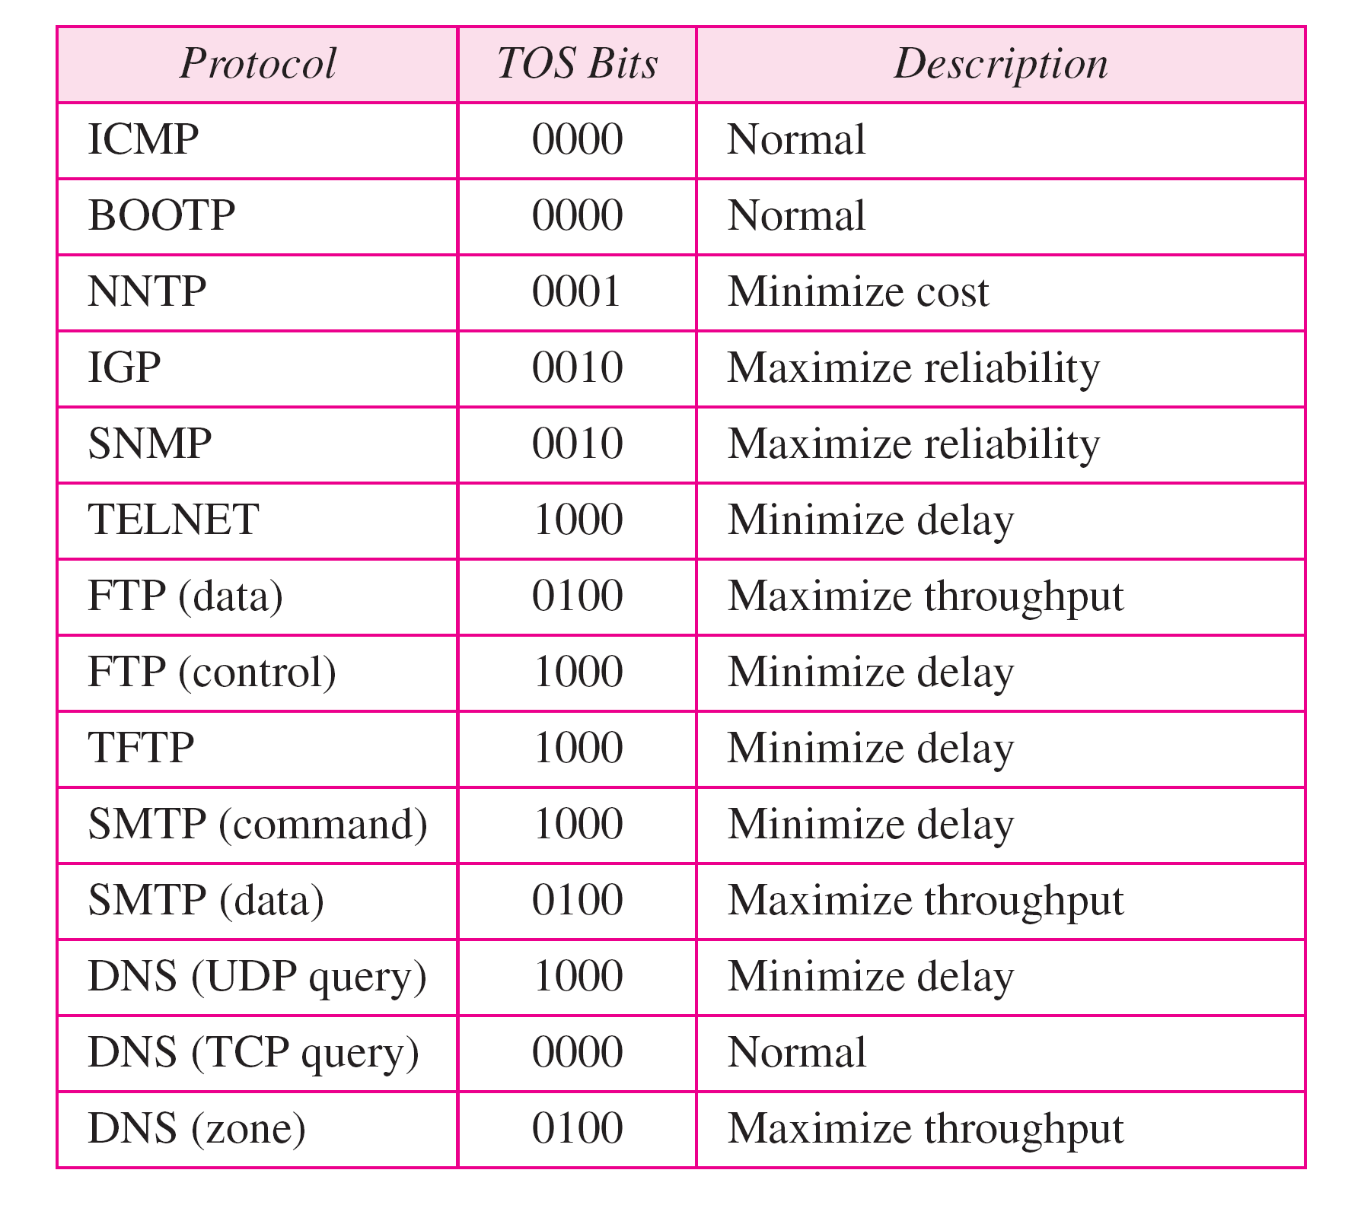
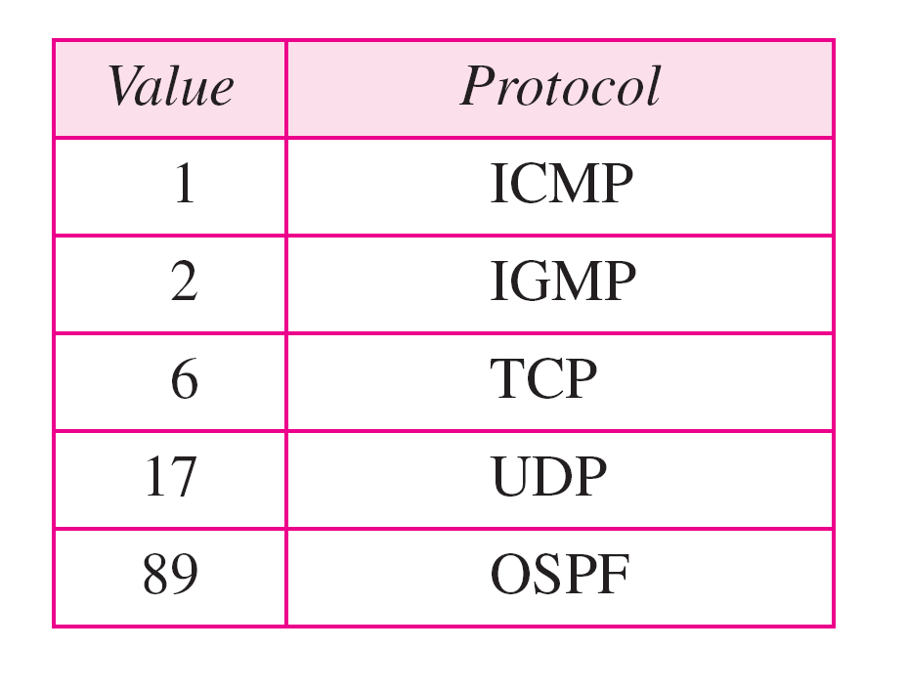
Protocol values
Default types of service

Slide 8
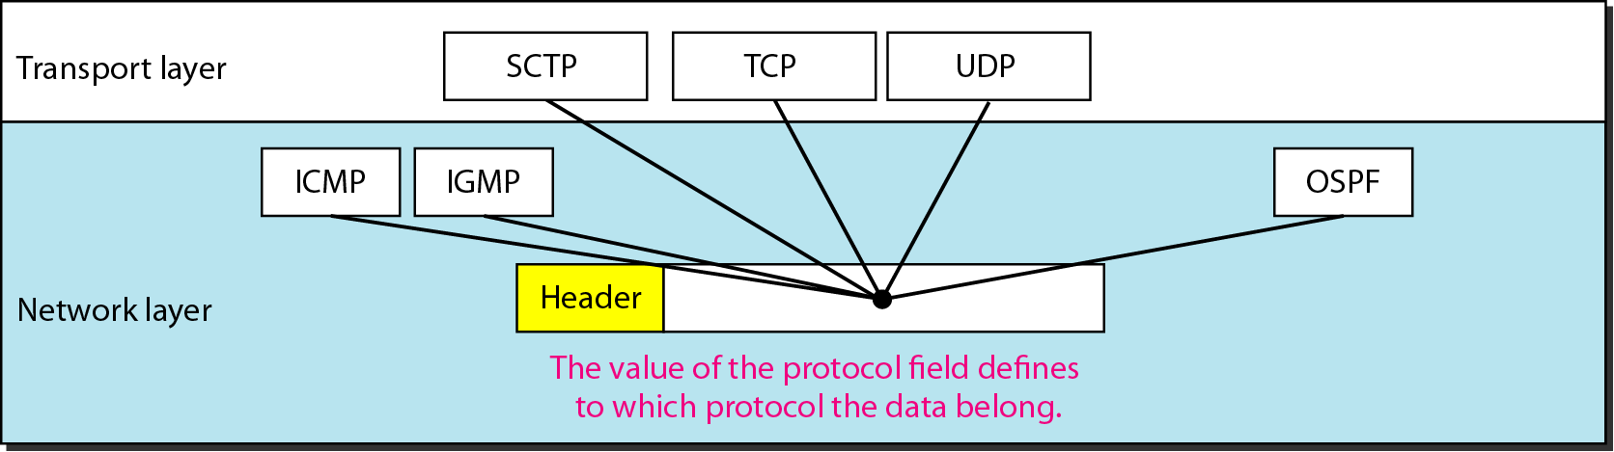
Protocol field and encapsulated data

